Slide 1
Windows Event Log Monitoring with Python
By Ashley Norman

Slide 2
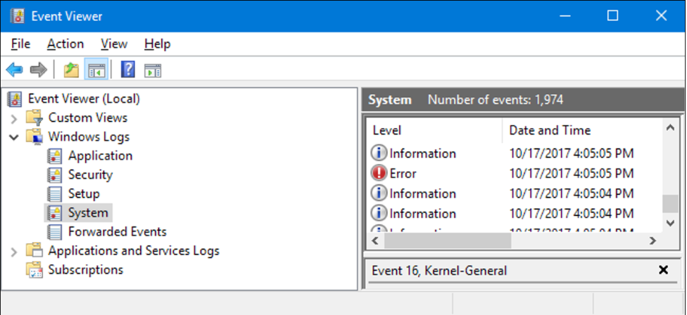
Windows Logs
Windows Event Logs: are a record of events stored on a Windows OS
Information stored depends on the category of event
System
Application
Security
Setup
Forwarded Events
Within the logs more information is contained

Slide 3
Event Log Monitoring
The collection and regular review of event logs is a simple but effective way to protect oneself
Create a baseline of “normal” activity
Identify and prevent attacks
Perform post breach forensics
Evidence of security breaches
Go unnoticed because of the large volume of data collected
Large corporations may log thousands of events per second
2012 Verizon Data Breach report: 85% of breaches took several weeks to be discovered, 84% had evidence of breach in their logs

Slide 4
Monitoring for Attacks
Hackers often try to hide their presence
Two examples:
Malware/virus
frequent crashes
Application logs and Event ID 1000
Pass the Hash
Popular attack that allows hackers to gain access to an account without needing to know the password
April 2022 RaaS platform called Hive leveraged this technique
Security logs and Event IDs associated with logins
4624
4625
4648

Slide 5
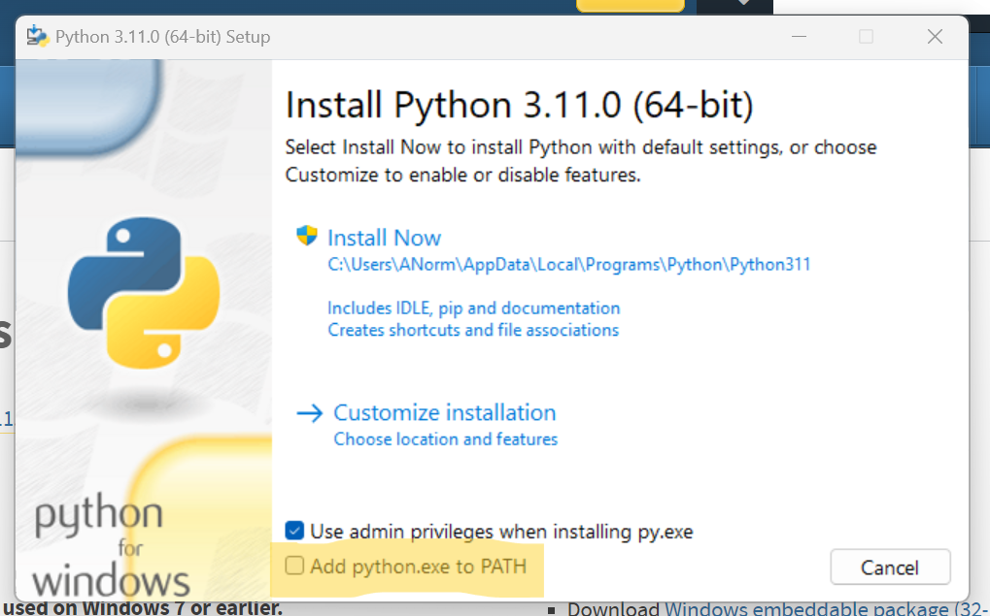
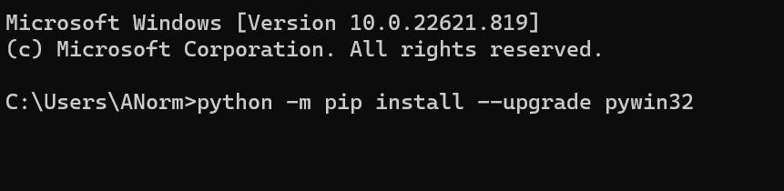
Installing Python
Python does not come installed on Windows machines
Download latest version for Windows
Make sure to check “Add Python.exe to PATH”
Install pywin32 module using the following command:

Slide 6
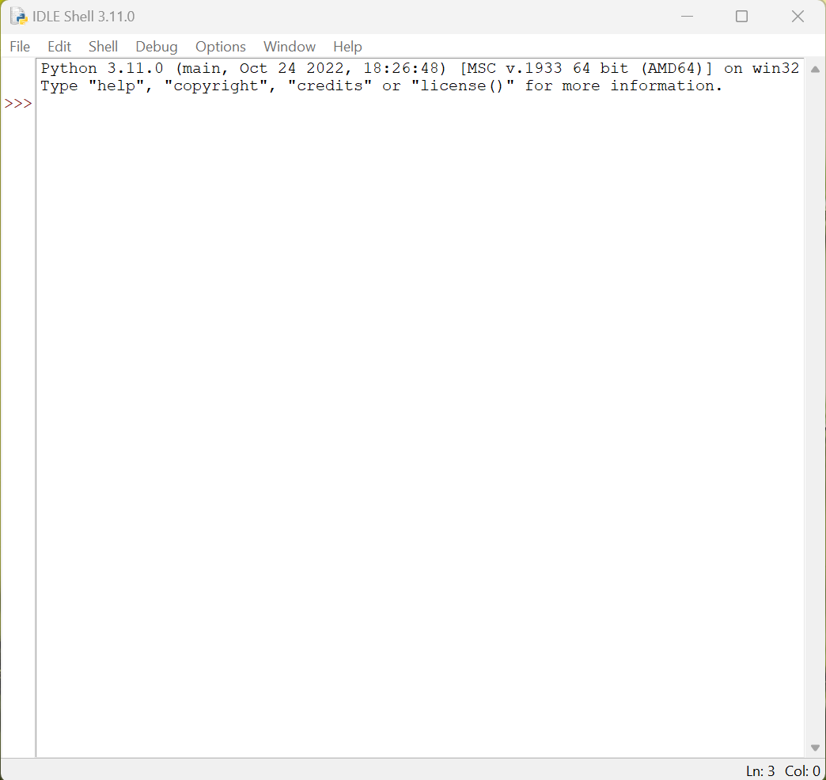

Slide 7

Windows Event Monitoring Demo

Slide 8
Application
Scalability
Windows Event Viewer
Script also for searching logs on a network with multiple machines
Configuration
Tested at the MN Air National Guard by the Defensive Cyber Operations Team
Used to conduct host based forensics

Slide 9
References
https://www.solarwinds.com/resources/it-glossary/windows-event-log
https://www.beyondtrust.com/blog/entry/windows-server-events-monitor
https://www.cyberark.com/resources/threat-research-blog/detecting-pass-the-hash-with-windows-event-viewer
https://www.crowdstrike.com/cybersecurity-101/pass-the-hash/
https://learn.microsoft.com/en-us/windows-server/identity/ad-ds/plan/security-best-practices/monitoring-active-directory-for-signs-of-compromise
https://docs.python.org/3.11/tutorial/index.html
https://www.oreilly.com/library/view/python-programming-on/1565926218/ch18s03s01.html
https://www.oreilly.com/library/view/python-programming-on/1565926218/ch18s03s02.html
https://stackoverflow.com/questions/11219213/read-specific-windows-event-log-event

